Slide 1
Setting Up Cryptographic Services

Slide 2
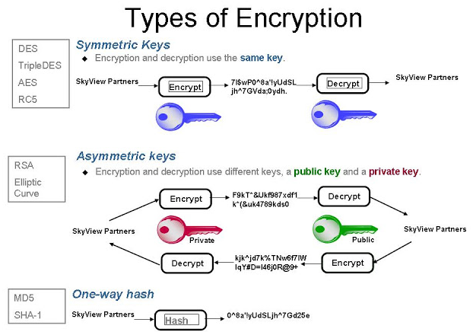
Source :https://medium.com/@peterchang_82818/

Slide 3
Introducing SSL
Secure Sockets Layer (SSL) is a standard security technology for establishing an encrypted link between a server and a client—typically a web server (website) and a browser, or a mail server and a mail client
SSL is a security protocol.
All browsers have the capability to interact with secured web servers using the SSL protocol. However, the browser and the server need what is called an SSL Certificate to be able to establish a secure connection.

Slide 4
When a browser attempts to access a website that is secured by SSL, the browser and the web server establish an SSL connection using a process called an “SSL Handshake”
Three keys are used to set up the SSL connection: the public, private, and session keys

Slide 5
Browser connects to a web server (website) secured with SSL (https). Browser requests that the server identify itself.
Server sends a copy of its SSL Certificate, including the server’s public key.
Browser checks the certificate root against a list of trusted CAs and that the certificate is unexpired, unrevoked, and that its common name is valid for the website that it is connecting to. If the browser trusts the certificate, it creates, encrypts, and sends back a symmetric session key using the server’s public key.
Server decrypts the symmetric session key using its private key and sends back an acknowledgement encrypted with the session key to start the encrypted session.
Server and Browser now encrypt all transmitted data with the session key.

Slide 6
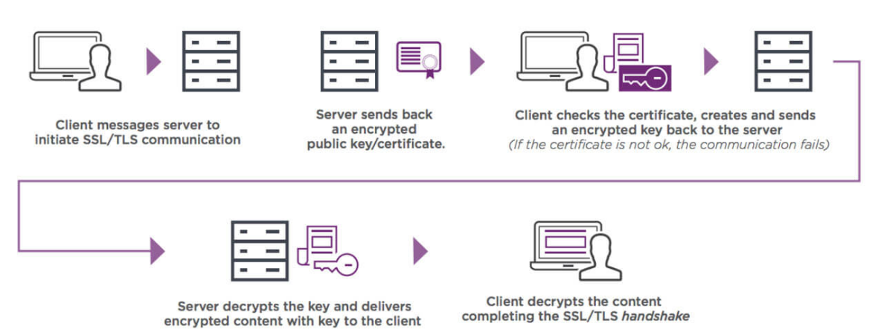
Source :https://www.entrustdatacard.com/pages/ssl

Slide 7
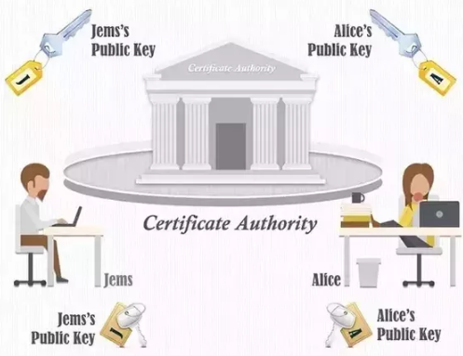
Certificate Authority

Slide 8
A certificate authority (CA) is a trusted entity that issues digital certificate that verify a digital entity's identity on the Internet.
The role of the CA in this process is to guarantee that the individual granted the unique certificate is, in fact, who he or she claims to be.
The CA is part of the public key infrastructure (PKI) along with the registration authority (RA) who verifies the information provided by a requester of a digital certificate.
Certificates given by CAs build trust between the users and the providers because they can ensure the validity of each other’s identities and authorities.

Slide 9
Proof of Authenticity: The Certificate Authority
A CA is used to guarantee the authenticity of a public key.
The role of the CA is to sign PKI certificates. Any server can generate a PKI certificate, and it is the role of the CA to sign these PKI certificates with its private key
But the CA must be known to everyone

Slide 10
Managing Certificates with openssl
To create and manage certificates, you can use the openssl command-line utility.
Creating a Self-Signed Certificate
To store the certificates that you are going to create. You can do this in the home directory of user root or else you can put the certificates in the directory /etc/pki/tls

Slide 11
Within this directory, you need four subdirectories to store the certificates:
certs
newcerts
private
crl

Slide 12
Certs : This is the location used to store all signed PKI certificates. The directory can be open for public access because it contains only public keys and no private ones.
Newcerts : This is where you temporarily store all new certificates until they have been signed. After you’ve signed them, you can remove them from this location.
private :This directory is used to store private keys. You must make sure that this directory is well protected because the private keys that are stored here are the proof of identity for your server. If the private keys are compromised, anyone can pretend to be your server. To protect the private keys, make sure that the private directory has permission mode 700 and that user root is owner of this directory.
Crl : A certificate revocation list (CRL) is a list of certificates that are invalid. If ever you need to revoke certificates, copy them to this directory.

Slide 13
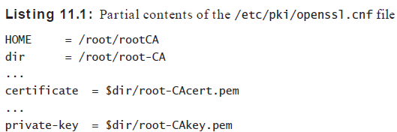
To create a certificate for your CA server, you can use the configuration file that you’ll find in /etc/pki/openssl.cnf. This file contains default settings that are used to facilitate the creation of new certificates.

Slide 14
After checking the default values you want to use in openssl.cnf, you can start creating your own self-signed certificate
The following command allows you to create a certificate that uses a 1024-bit RSA key with a validity of 10 years:
openssl req -newkey rsa:1024 -x509 -days 3650

Slide 15
A more complex example follows, where a specific mention is made of where the private key and certificate must be written.
openssl req -newkey rsa:2048 -x509 -days 3650
-keyout private/my-CAkey.pem –out my-CAcert.pem
When you are creating a key, the openssl command prompts for a passphrase

Slide 16
Creating a Self -Signed Certificate
Use yum install -y crypto-utils mod_ssl to install the RPM package that contains the genkey command
genkey --days 365 yourserver.example.com
command automatically places the resulting PKI certificate and private key in the correct directories,
/etc/pki/tls/private
/etc/pki/tls/certs.

Slide 17
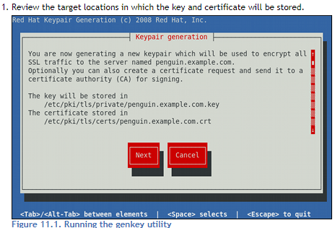
On the next screen, select the key size you want to use. The default key size is set to 1024 bits

Slide 18
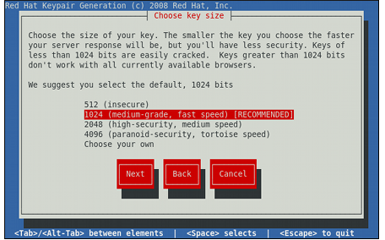

Slide 19
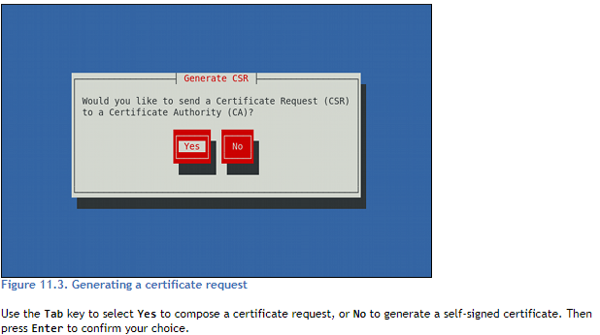

Slide 20
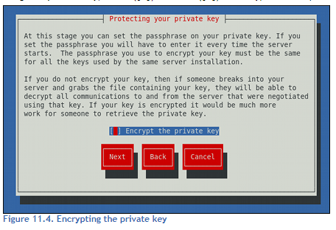

Slide 21
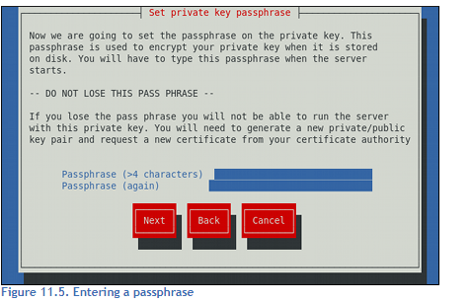

Slide 22
Once the key has been generated, genkey asks whether you want to create a certificate signing request. you can skip this step by answering No.
To protect your private keys with a passphrase, so select Yes
Enter the appropriate information to identify your server.
The appropriate identification, the public and private keys are written to the appropriate directories

Slide 23
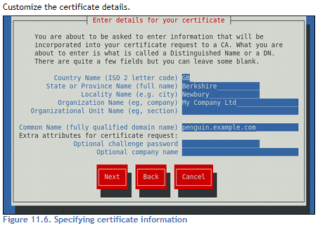

Slide 24
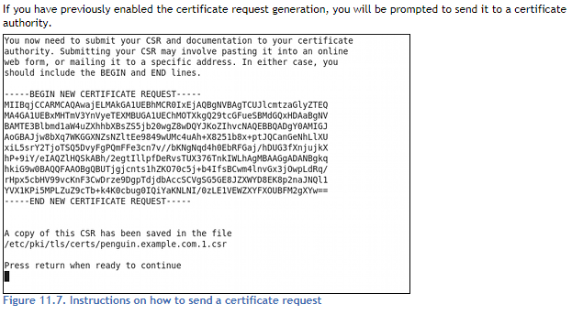

Slide 25
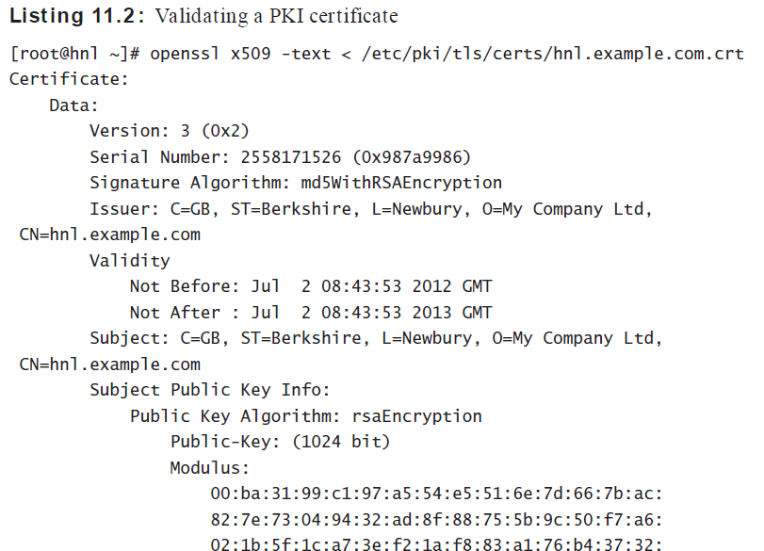
To verify the contents of the key

Slide 26
Working with GNU Privacy Guard
While PKI certificates and SSL are primarily used with web servers
To protect files is by using GNU Privacy Guard (GPG).
GPG is commonly used in email communication, and it is also used to encrypt and decrypt files so that they can be securely transported.

Slide 27
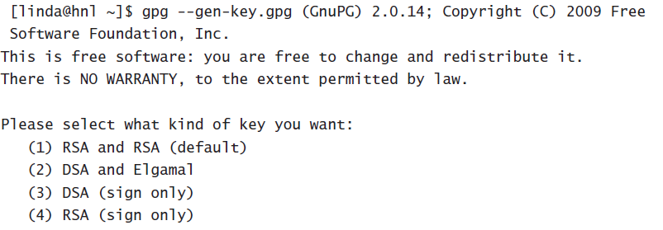
Creating GPG Keys
To create a key pair, use gpg --gen-key
Next you’ll need to enter a passphrase to protect the key

Slide 28
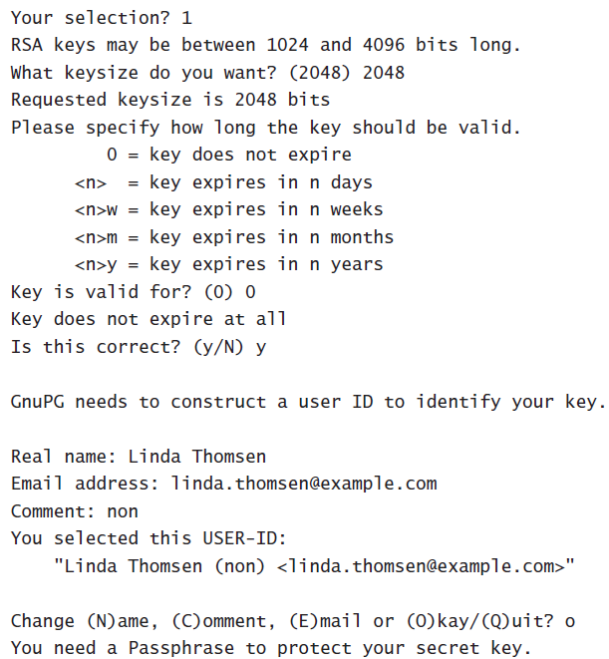

Slide 29
While creating the key pair, a keyring is created. This keyring consists of two files that are written to the .gnupg directory in the home directory of the user.
The public key is written to ~/.gnupg/pubring.gpg
The private key is written to ~/.gnupg/secring.gpg

Slide 30
key transfer means you have to export the key. To do this, use gpg --export command.
For example, use gpg --export -a to dump the public key to the STDOUT.
To copy it to a file, redirect the output of the gpg --export -a command to a file.
Other user can now import the key using the gpg --import < keyfile command.
Eg : gpg --import < linda.key

Slide 31
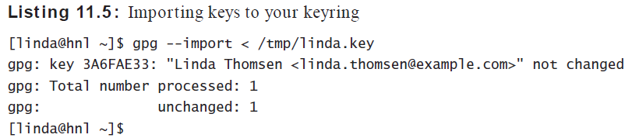

Slide 32
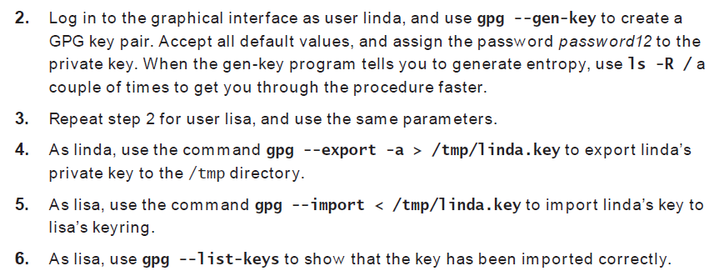
Creating and Exchanging GPG Keys
1. Create two users named linda and lisa, and give them the password password.

Slide 33
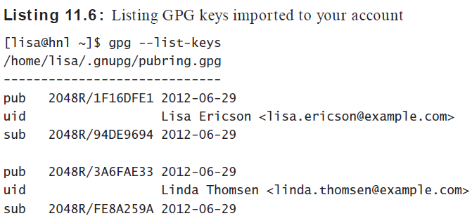
Managing GPG Keys
To see the keys that are currently available, use gpg --list-keys
If you want to check your private key, you can use gpg --list-secret-keys

Slide 34
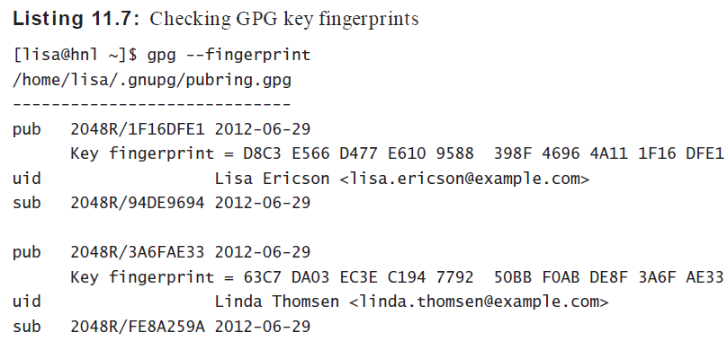
GPG key fingerprint printed on their business card. So, if you need to verify that you’re dealing with the right person, you can compare the result of the gpg --fingerprint command

Slide 35
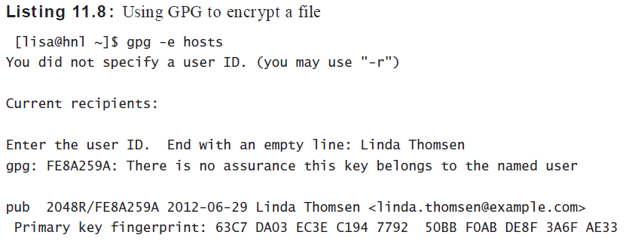
Encrypting Files with GPG

Slide 36
The receiver of the encrypted file can decrypt it by using the command gpg -d.
The command gpg -d myfile.gpg > myfile will extract the contents of the GPG encrypted fi le to myfile.

Slide 37
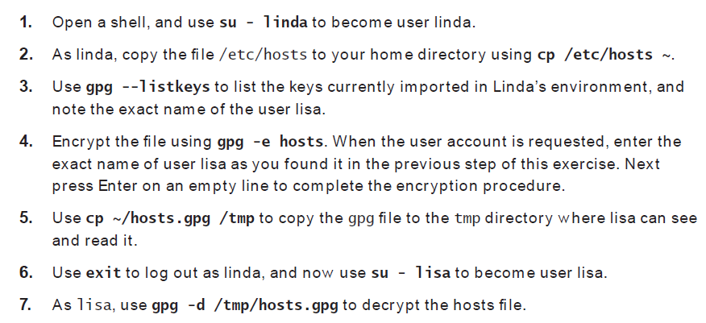
Encrypting and Decrypting Files

Slide 38
GPG Signing
To sign data, the user’s private key is used.
Use gpg -e -s file if you want to encrypt and sign a file at the same time
If you have the public key of the sender on your system, it will automatically be opened
If you’ve received a file that is signed with GPG, you can use gpg -d to open it

Slide 39
Signing RPM Files
To ensure that you can trust the RPM files you’re installing, many RPMs are signed with a GPG key.
When signing RPM packages, the creator of the RPM package needs to go through a signing procedure
This signature can then be checked against the GPG key, which should be publicly available and imported by the person who wants to install the package

Slide 40
To begin, you need a GPG key pair. To create it, use the gpg --gen-key command
After generating the GPG key pair, you need the key ID, and based on that, you need to create a key file.
gpg -a -o ~/RPM-GPG-KEY-test --export 455F7CBF
Next, in the home directory of that same user, you have to create an .rpmmacros file
%_gpg_name 455F7CBF

Slide 41
At this point, you can (re)sign the package. The following command is used to sign an RPM package
To use it, you should publish the key together with the signed package and put it on a web server, it is a good idea to test it to see whether it works. The following two commands perform a local test

Slide 42
https://forms.gle/fKPbEtMny5ZqXaWM6

